Slide 1
Data Consumers and Producers

Slide 2
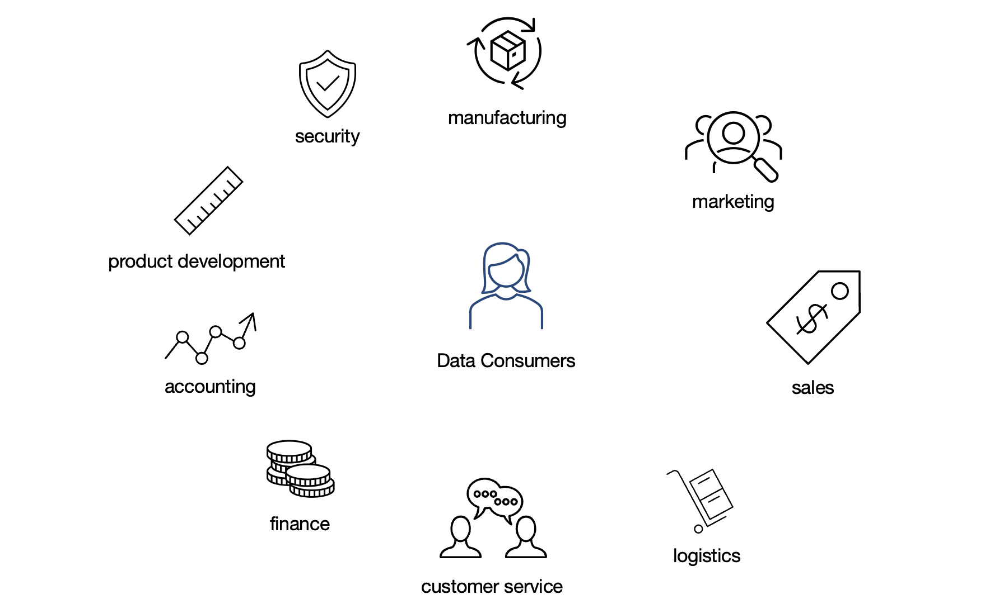
Data Consumers

Slide 3
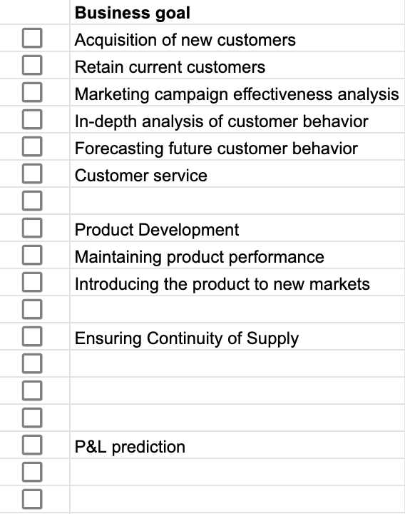
Business goals

Slide 4
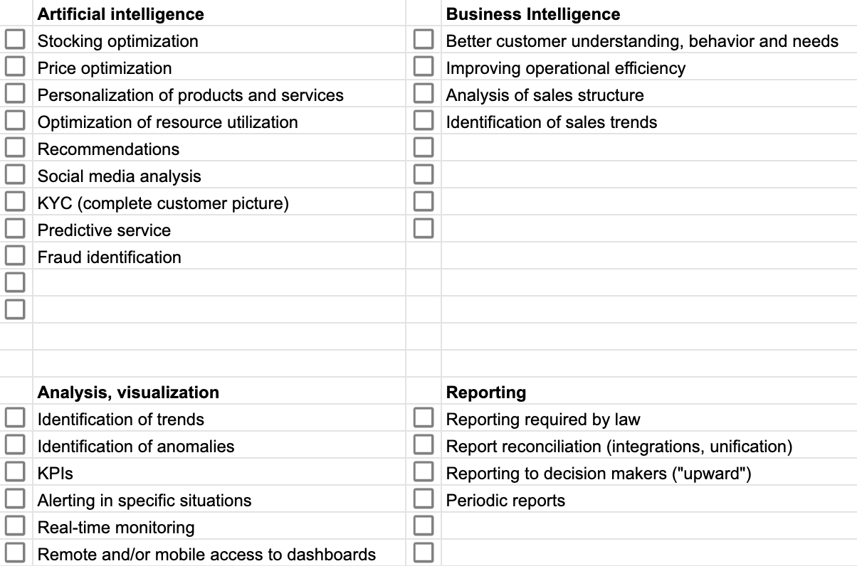
Use-cases

Slide 5
Data producers
event data, entity data

Slide 6
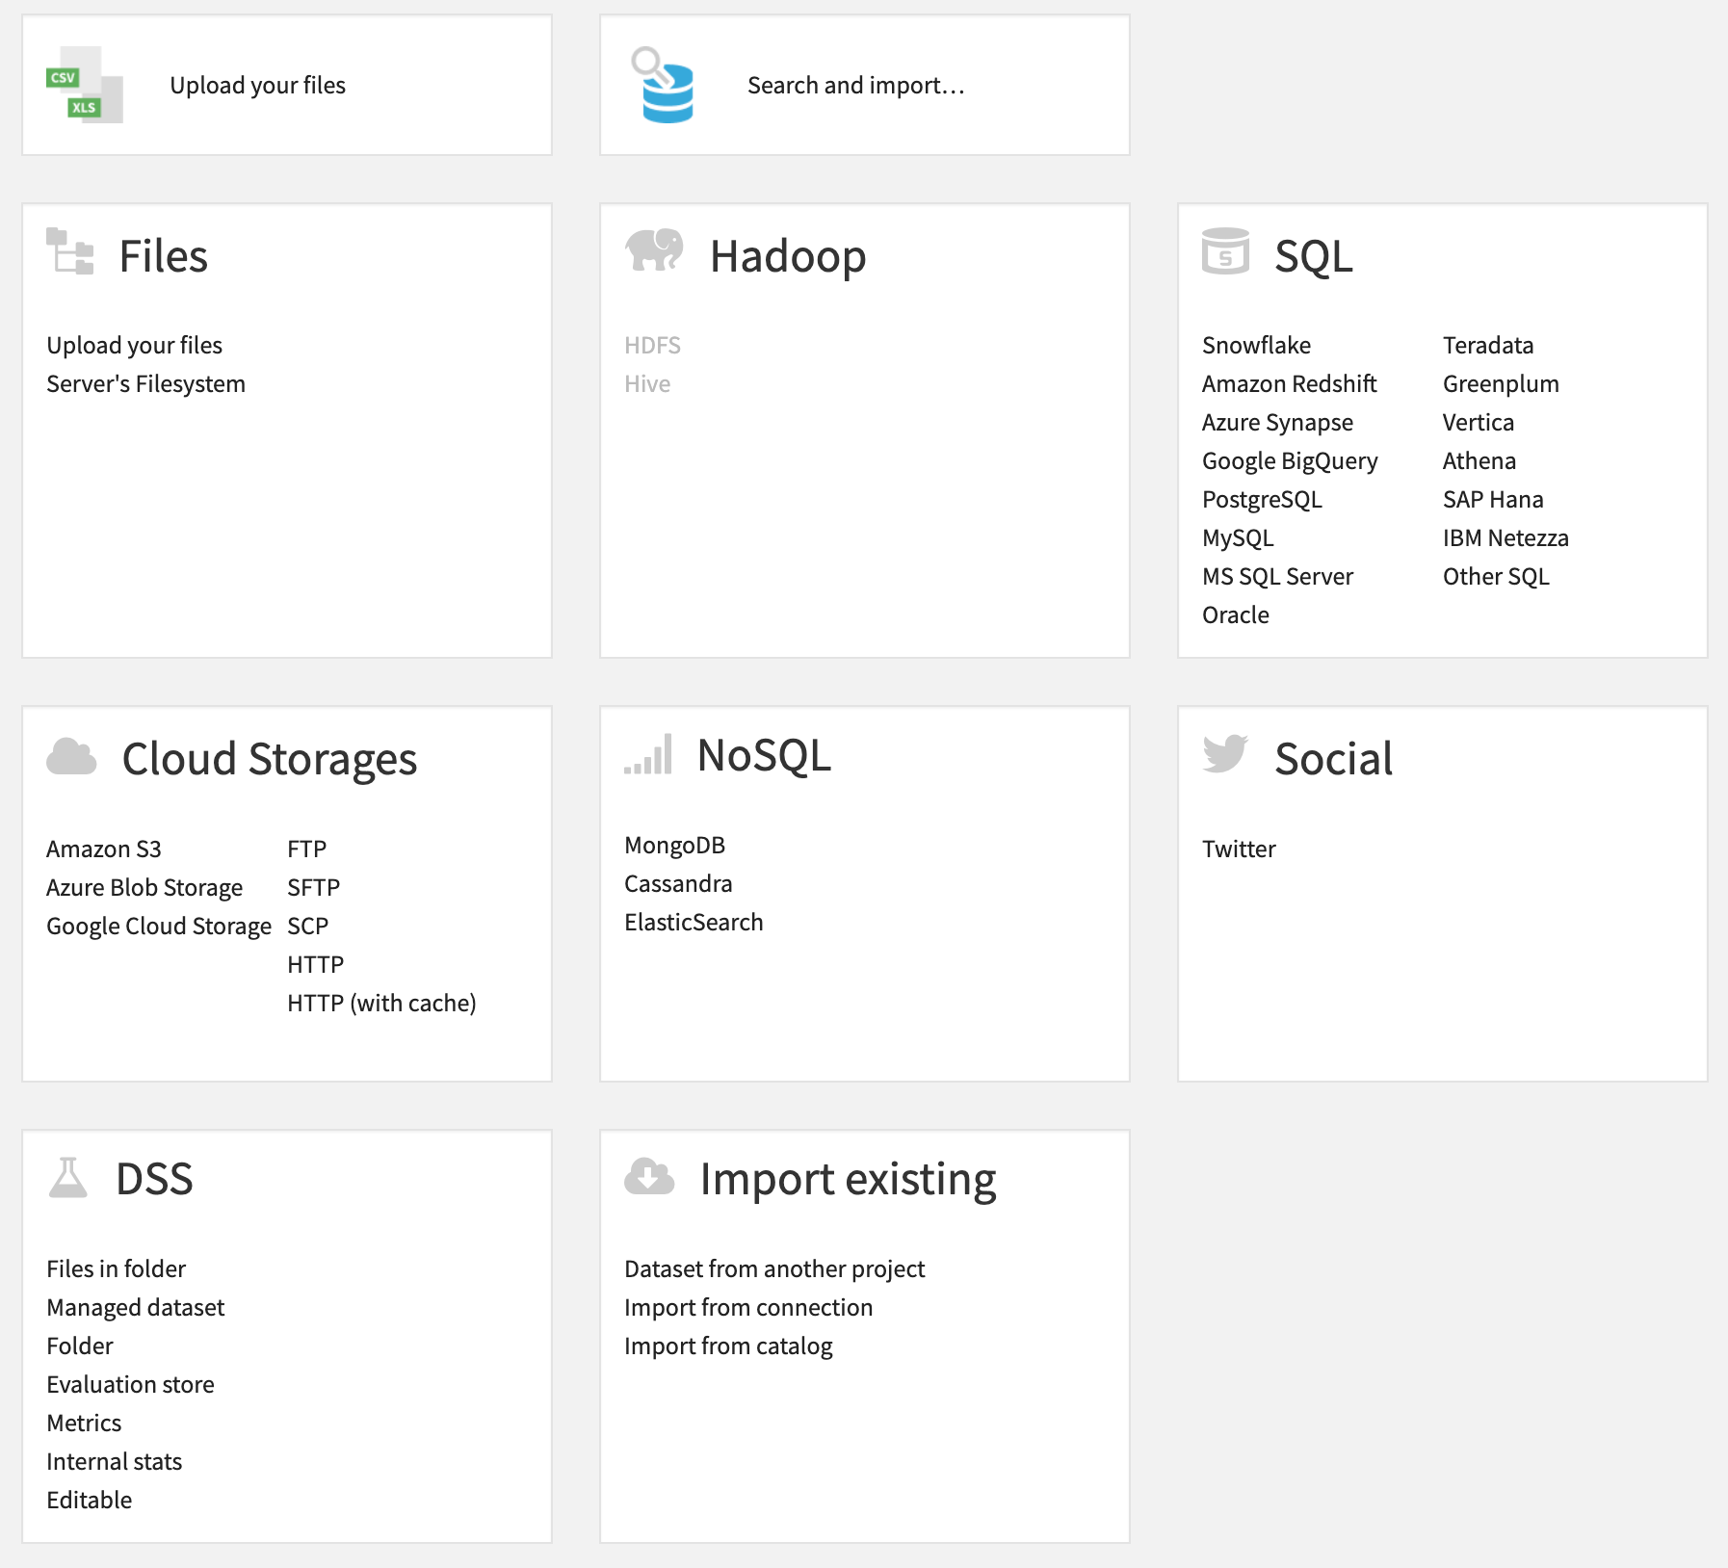
Entity data - sources
Transaction systems
- ERP
- CRM
Databases
Data warehouses
Files and (distributed) file systems
External sources, API (Application Programming Interface)

Slide 7

Event data – IT systems
Data replication
Data syncing
Running a job
Deleting a job
...

Slide 8

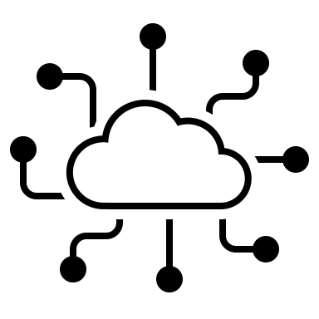
Event data – sensors
Motion detection
Voice detection
Temperature detection
Smoke detection
…
wearable
IoT

Slide 9

Event data – mobile app/website
User behaviour:
- Downloads
- Clicks
- Form completion
- Comments
mobile app/device
www

Slide 10
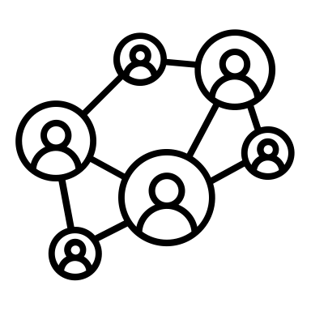
Event data – social media
User Behavior:
- Publish sth.
- Share an object (entry, photo, video, ...)
- Like an item
- Add hashtag
- Provide feedback
social media

